Slide 1
More on Time Complexity

Slide 2
Three Examples with Nested Loops
Determine the time complexity

Slide 3
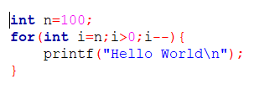
More Examples
Example 4
i takes the values:
n, n-1, n-2, …, 0
It runs n+1 times
Time complexity = O(n)

Slide 4
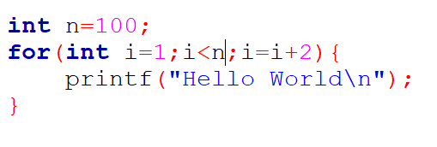
More Examples
Example 5
i takes the values:
1, 3, 5, …, n+sth
It runs for half of the values from 1 to n
Time complexity = n/2 =O(n)

Slide 5
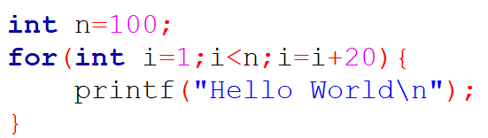
More Examples
Example 6
i takes the values:
1, 21, 42, …, n+sth
It runs for 1/20 th of the values from 1 to n
(which is 5 in this case)
Time complexity = n/20 =O(n)

Slide 6
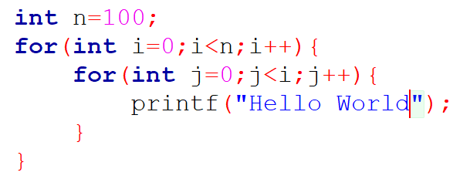
More Examples
Example 7

Slide 7
More Examples
i | j | stmt
0 | 0 | 0
1 | 0 | 1
 | 1(X)
2 | 0 | 2
 | 1
 | 2(X)
3 | 0 | 3
 | 1
 | 2
 | 3(x)
… | … | …
n | 0…n(X) | n
Example 7

Slide 8

More Examples
i | j | stmt
0 | 0 | 0
1 | 0 | 1
 | 1(X)
2 | 0 | 2
 | 1
 | 2(X)
3 | 0 | 3
 | 1
 | 2
 | 3(x)
… | … | …
n | 0…n(x) | n
Example 7

Slide 9
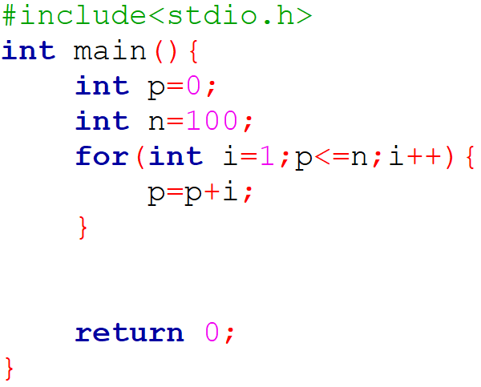
More Examples
Example 8
i
p
n=100
1
0+1=1
2
1+2=3
3
3+3=6
4
6+4=10
k
1+2+3+…+k

Slide 10
More Examples
i
p
n=100
Example 8
1
0+1=1
2
1+2=3
3
3+3=6
4
6+4=10
k
1+2+3+…+k
p >n
K(k+1)/2 >n
O(root(n))
Note: k is the number of times the loop ran

Slide 11
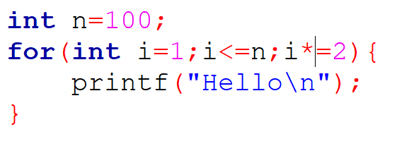
More Examples
Example 9

Slide 12
More Examples
Example 9
How many times will the statement run?
i
Printf()
1
1
2
1
4
1
…
…
2^{k}
1

Slide 13
More Examples
Example 9
How many times will the statement run?
i
Printf()
1
1
2
1
4
1
…
…
2^{k}>n
k>log₂n
2^{k}
1
O(log₂n)
Note: k is the number of times the loop ran

Slide 14
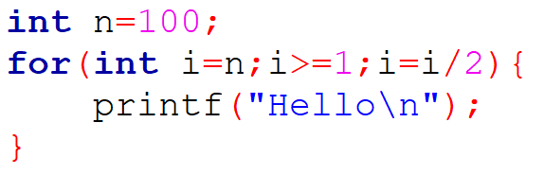
More Examples
Example 10
How many times will the statement run?
i
Printf()
n
1
n/2
1
n/2²
1
n/2^{k}<1
…
…
2^{k}>n
k>log₂n
n/2^{k}
1
O(log₂n)
Note: k is the number of times the loop ran

Slide 15
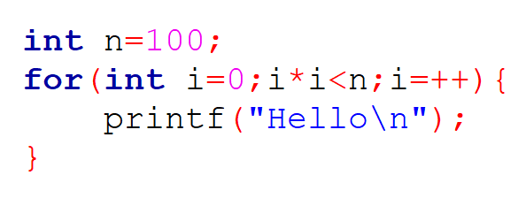
More Examples
Example 11

Slide 16
More Examples
Example 11
How many times will the loop run?
i²<n
i<root(n)
O(root(n))

Slide 17
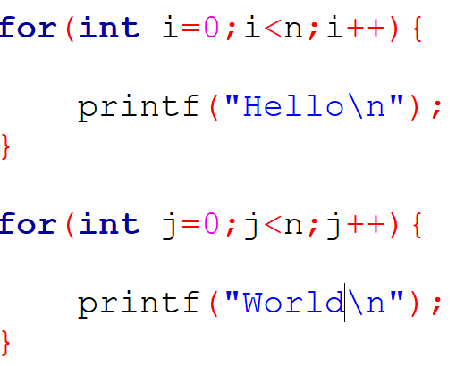
More Examples
Example 12

Slide 18
More Examples
Example 12
O(2n) = O(n)

Slide 19
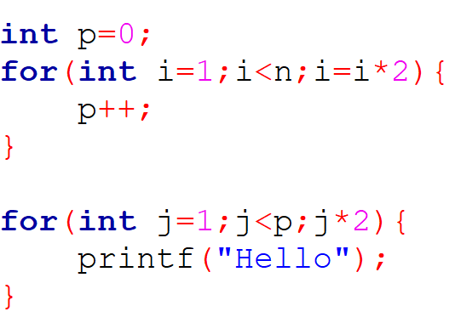
More Examples
Example 13 (determine the time complexity for the 2nd loop only)
This loop will run log(n) times
Hence the value of p will be log(n)
This loop will run log(p) times
Total time
= O(logp)
= O(loglog(n))
= O(loglogn)

Slide 20
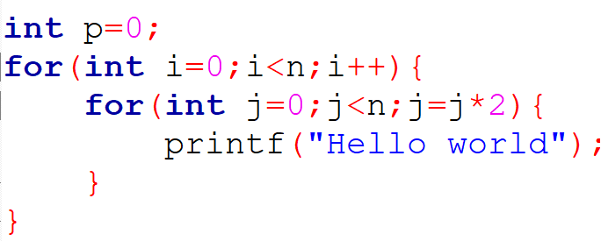
More Examples
Example 14 (do it yourself)

Slide 21
More Examples
Example 14 (do it yourself)
O(nlogn)

Slide 22
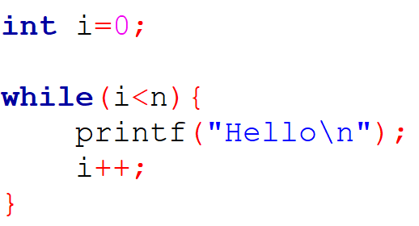
More Examples
Example 15
1
n+1
n
n
O(n)

Slide 23
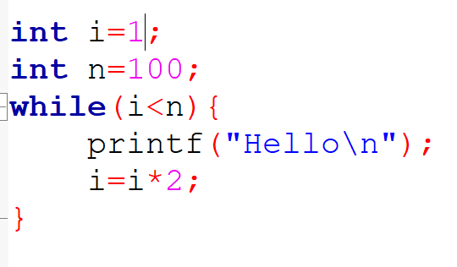
More Examples
Example 16
How many times will the statement run?
i
Printf()
1
1
2
1
4
1
…
…
2^{k}
1

Slide 24
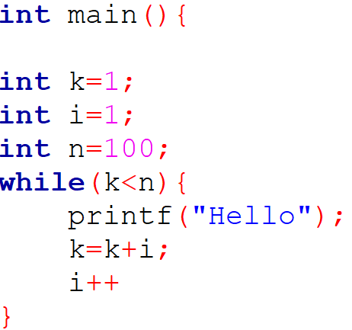
More Examples
Example 17

Slide 25
More Examples
Example 17
Note:
i is increasing k
k is used to terminate the loop
i
k
n=100
1
0+1=1
2
1+2=3
3
3+3=6
4
6+4=10
m
1+2+3+…+m

Slide 26
More Examples
Example 17
Note:
i is increasing k
k is used to terminate the loop
i
k
n=100
1
0+1=1
2
1+2=3
k>=n
3
3+3=6
4
6+4=10
m
1+2+3+…+m

Slide 27
More Examples
Example 17
Note:
i is increasing k
k is used to terminate the loop
i
k
n=100
1
0+1=1
2
1+2=3
k>=n
O(root(n))
3
3+3=6
4
6+4=10
m
1+2+3+…+m

Slide 28
Thank You

